Slide 1
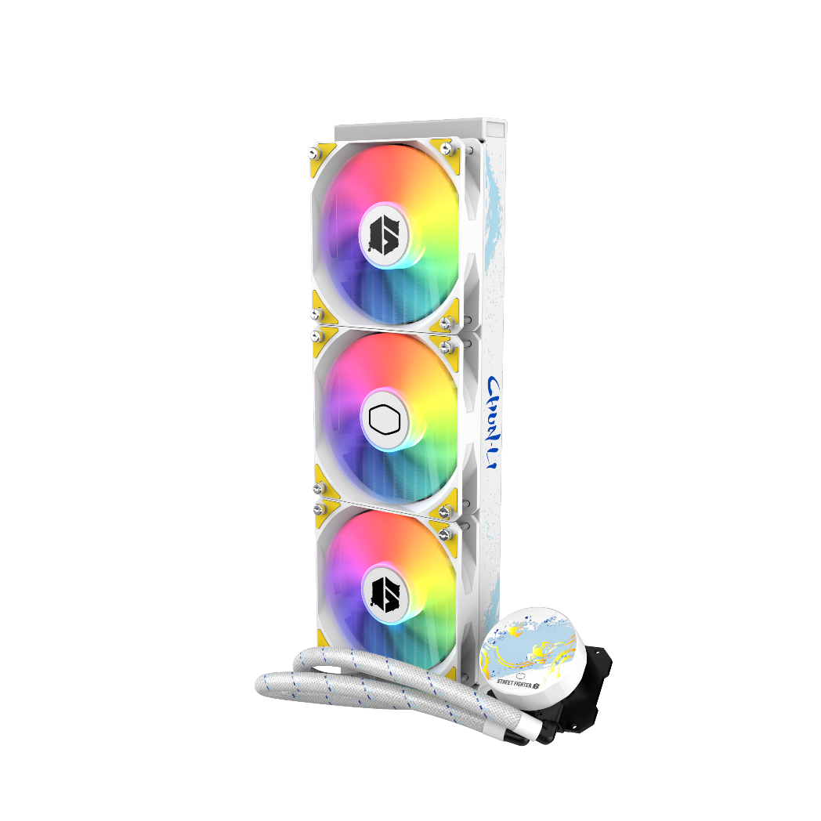
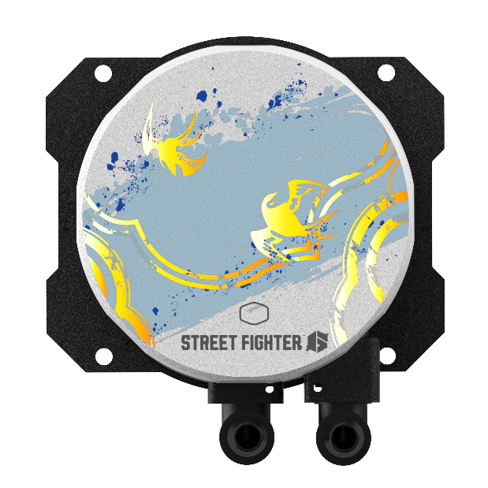
SPECIAL EDITION
Cooler Master is building upon the success of the MasterLiquid Lite Series with a redesigned and improved release of the MasterLiquid 360L Core, now featuring an exclusive Street Fighter design, celebrating the original classic character, Chun-Li. With the new dual chamber Gen S, water flow and pressure have been enhanced in combination with the new customized copper base to precisely target heat spots. The radiator surface area is larger than before for improved cooling performance. The included thermal paste has been upgraded to our premium CryoFuze thermal paste for even better heat conductivity. The new MasterLiquid L Core is the representation of Cooler Master’s continuous improvement and innovation.
MASTERLIQUID 360L CORE
SF6 CHUN-LI
New Dual Chamber Gen S
Water flow and pressure have been enhanced in combination with the new customized copper base to precisely target heat spots.
Larger Surface Area
Increased surface area of the radiator fins improve heat dissipation.
CryoFuze Thermal Paste
Included premium CryoFuze thermal paste for even better heat conductivity.
Classic Design Tone
New design elements refresh the aesthetics for a closer minimalist look.
Street Fighter Design
An exclusive collaboration with Street Fighter 6 for all the fans of the original classic character – Chun Li

Slide 2
New Dual Chamber Gen S – Water flow and pressure have been enhanced in combination with the new copper base to precisely target heat spots.
Larger Surface Area – Increased surface area of the radiator fins improve heat dissipation.
Street Fighter Design - An exclusive collaboration with Street Fighter 6 for all the fans of the original classic character – Chun Li.
CryoFuze Thermal Paste – Included premium CryoFuze thermal paste for even better heat conductivity.
Classic Design Tone – New design elements refresh the aesthetics for a classic minimalist look.
Product Name |  | MasterLiquid 360L Core SF6 Chun-Li
Product Number |  | MLW-D36M-A17PZ-CL
Exterior Color |  | White
CPU Socket | Intel | Intel® LGA 1700 / 1200 / 1151 / 1150 / 1155 / 1156 / socket
 | AMD | AMD® AM5 / AM4 / AM3+ / AM3 / AM2+ / AM2 / FM2+ / FM2 / FM1 socket
Radiator | Material | Aluminum
 | Dimensions (L x W x H) | 394 x 119.6 x 27.2mm(15.5 x 4.7 x 1.1 inch)
Pump | Dimensions (L x W x H) | 81 x 76 x 47 mm (3.2x 3 x 1.9 inch)
 | MTTF | > 70,000 hours
 | Noise Level (Max) | 12 dB(A)
 | Connector | 3-Pin
 | Rated Voltage | 12 VDC
 | Power Consumption | 3.96 W
Fan | Dimensions (L x W x H) | 120 x 120 x 25 mm(4.7 x 4.7 x 1 inch)
 | Quantity | 3 Pcs
 | LED Type | ARGB
 | Speed (RPM) | 650 ~1750 ± 10%
 | Airflow (Max) | 122.2 m³/h (71.93 CFM)
 | Noise Level (Max) | 27.2 dB(A)
 | Pressure (Max) | 1.86 (mmH2O)
 | Bearing | Rifle
 | MTTF | >160,000 hours
 | Power Connector | 4-Pin PWM
 | Rated Voltage | 12 VDC
 | Rated Current | 0.26A
 | Safety Current | 0.37A
RAM Clearance |  | N/A
Warranty |  | 3 years
EAN code | 4719512142011
UPC code | 884102114335
Net weight | 1.80 kg
Gross weight | 2.50 kg
Package dimension (L x W X H) | 44 x 23.2 x 13.9 cm
Carton dimension (L x W x H) | 57.5 x 45.7 x 26.5 cm
Units/CTN | 4
Cont. | W/ Pallet | Carton/ Pallet | W/O Pallet
20’ | 1120 | 28 | N/A
40’ | 2240 | 28 | N/A
40 HQ | 2560 | 32 | N/A

